Slide 1
EU Policy Framework and Funding
Guido Castellano, DG HOME
Unit E1, “Fund Coordination”

Slide 2
Content
Overview of DG HOME Funds
Funding of Reception Systems under AMIF
Pact on Asylum and Migration
Funding Sources
Your feedback

Slide 3
DG HOME Funds

Slide 4

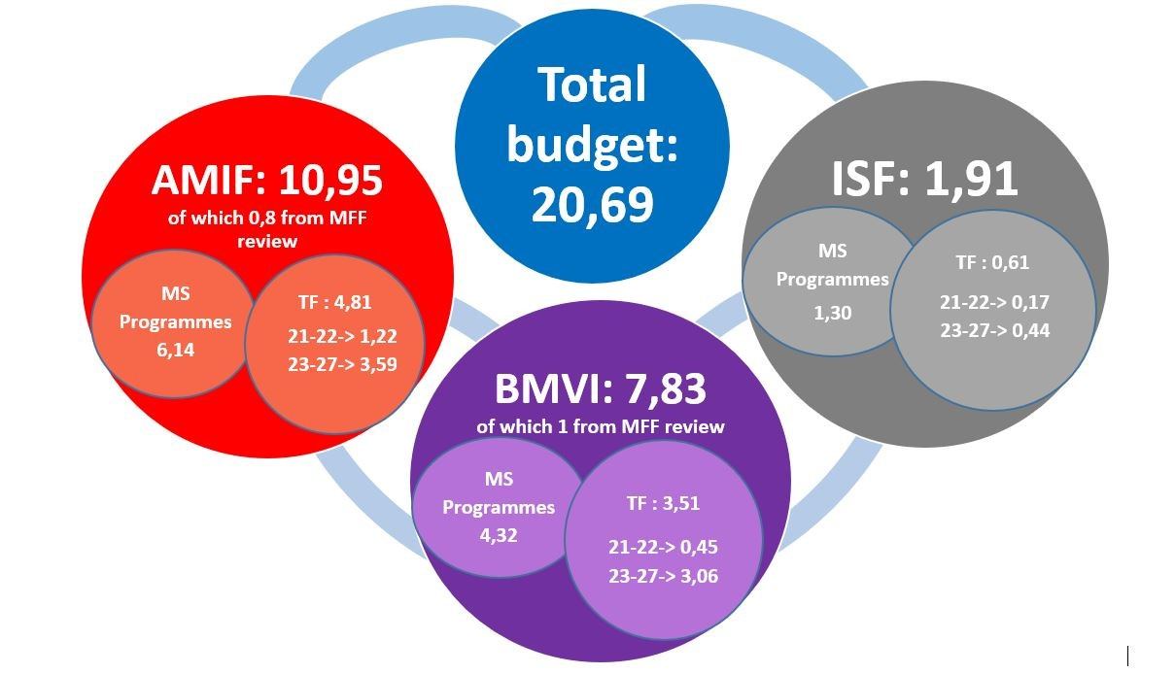
Home Affairs Funds

Slide 5
The legal bases 2021–2027
Internal policy instruments
Fund | Specific Objectives
Asylum, Migration and Integration Fund (AMIF) | Common European Asylum System – Legal migration and Integration – Return and Readmission – Solidarity
Border Management and Visa Instrument (BMVI) | Border management at the external borders – Common visa policy
Internal Security Fund (ISF) | Exchange of information – Cross-border cooperation – Member States’ capabilities to prevent/combat crime
The Common Provisions Regulation (CPR)

Slide 6
Two strands of programming
78 MS Programmes (+3 SAC^{(*)}) | 1 Thematic Facility
By Member State and by Fund | By Fund
Multiannual (2021 – 2027) | Annual or multiannual (2-3 years)
Programmed and implemented by the Member States (shared management) | Programmed by COM, implemented by COM (directly or indirectly) and by the Member States
Submitted by the Member States and adopted by the Commission | Adopted by COM and Member States (Comitology)
Reflect national strategies & needs | Promote actions of high EU added value and transnational cooperation
Can be amended (on initiative by the MS) | Can be amended (on initiative by COM)
(*) Schengen Associated Countries (BMVI): Switzerland, Norway, Iceland, Liechnstein
Notes:
Programming for AMIF specifically (inspired from hidden slides 16-17)

Slide 7
Implementation modes
Member States Programmes
Thematic Facility
Union Actions
DIRECT / INDIRECT MANAGEMENT
Transnational
High EU added Value
Grants and Procurement (calls launched by COM)
SHARED MANAGEMENT
Priorities laid down for each MS in Programmes covering the whole MFF
MS publish and manage the calls
Reporting obligations (financial and monitoring data)
Specific Actions
SHARED MANAGEMENT
High EU added value
Additional allocation to MS Prog.
Solidarity Actions
SHARED MANAGEMENT (Financing Not Linked to Costs)
Resettlement
Relocation
Emergency Assistance
ALL MANAGEMENT MODES
Flexible emergency response

Slide 8
Questions?

Slide 9
Funding of Reception Centres under AMIF

Slide 10
AMIF Specific Objectives (SO)
The establishment or improvement of open reception infrastructure.
SO1
Strengthening and developing all aspects of the Union Asylum System
SO2
Strengthening and developing legal migration and integration of third country nationals in Member States
SO3
Countering Illegal migration and contributing to effective reintegration in the Country of Origin
SO4
Enhancing of Solidarity and fair sharing of responsibility
Scope of support under SO1 (examples):
• Capacity building for Asylum Procedures (e.g. Infrastructure & Staff Training) • Reception services for TCNs (e.g. legal & interpretation services etc.) • Specialised support for vulnerable persons, unaccompanied minors & victims of trafficking (e.g. family tracing, psychosocial support, rehabilitation services)

Slide 11
Budgetary structure in AMIF

Slide 12
Strategic Objectives (EUR Billion)
Programmed at EU level, May 2025. Source: Cohesion Open Data Platform

Slide 13
Questions?

Slide 14
Pact on Asylum and Migration

Slide 15
















The 10 building blocks
Common
Information
Systems /
Eurodac
STRUCTURE
Resettlement Inclusion
Integration
Border
Systems
I. Purpose and substance
II. Member States
Safeguards &
Rights
Rethinking
Reception
Regulatory
Organisation and administrative processes
Capacities (human resources, infrastructure and equipment)
Contingency &
Crisis
Procedures that converge
III. Commission and Agencies
Legal obligations
Practical support
Solidarity
Return
Responsibility
IV. Key milestones to consider

Slide 16
Horizontal priorities (COMM recommendations)
Implementation of EURODAC
Functioning of Reception Systems
Implementation of the Asylum and Migration Management Regulation (Dublin transfers and Solidarity mechanism)
Support to (independent) Judiciary
Screening and Border Procedures
Fast and smooth Returns
Independent Monitoring System

Slide 17
Possibilities for funding (examples, non-exhaustive)
Under AMIF and/or BMVI (depending on scope):
Machinery/equipment (e.g. for EURODAC, border controls, screening, asylum/return procedures…)
Infrastructures, incl. upgrading/refurbishment (e.g. for screening, reception centres, alternative to detention, return procedures…)
Legal counselling (setting-up of relevant services)
Independent monitoring mechanism for fundamental rights (setting-up of relevant services)
Provision of family tracing services and procedural support (setting-up of relevant services)
Enhancing national and transnational coordination and cooperation towards more efficient procedures (e.g. in relation to asylum, return, Dublin)
Training …

Slide 18


Building Block 3: “Rethinking Reception”
Reception Capacity: the ability to provide material reception conditions to applicants for international protection, taking into account their gender, age and any special reception needs.
The recast Reception Conditions Directive:
  Scaling up and rethinking the current system
  New tools of management of reception, for better flexibility and efficiency

Slide 19
Building Block 3: “Rethinking Reception”
Member States should consider reviewing the organisation of national reception systems to optimise how they are organised.
Also implement new technologies that offer automated tools
  E.g. establishing an integrated case management system

Slide 20
Digital Aspects under the Pact
Setting up a new Eurodac systems for Pact purposes while ensuring the interoperability of Eurodac with other large-scale EU information systems for data exchange at Union level
  Enhanced sharing of data between Member States’ IT systems and exploring the idea of building an EU-level case management system that would allow efficient intra-EU communication and tracking concrete cases caused by e.g. secondary movements.
Improving and connecting national IT systems (within the same Member State) recording personal data and legal status of migrants while managing access between national authorities/stakeholders.

Slide 21


Operational And Financial Support
Newly Available Financial Resources
Pact and Ukraine Specific Action
Mid-term review of AMIF and BMVI Programmes
EUR 3 Billion
AMIF
Around EUR 1 Billion
BMVI
Around EUR 600 Million
National Budgets
Member States should consider using their National Budgets or other EU Funds,
Such as the Cohesion Policy Funds as well as the Technical Support Instruments.

Slide 22
Questions?

Slide 23
Funding Opportunities (Reception, Digitasation)

Slide 24
AMIF
AMIF Programmes:
National Authorities in charge of the programmes and programmes’ websites: https://home-affairs.ec.europa.eu/funding/funding-contacts_en
AMIF Thematic Facility: Asylum, Migration and Integration Fund (2021-2027) - European Commission (europa.eu)
WHEN to apply?
Follow the Funding and tenders portal regularly
A minimum of 4 months between publication and submission
HOW to apply?
Proposals are submitted electronically through the Funding and tender page
You need to register on the Participant Register and have an EU login
Available information at - How to participate (europa.eu)

Slide 25
Other sources of funding
National Bugets
Other EU funds:
  Cohesion policy funds (ESF+, ERDF)
  Recovery and Resilience Facility
  Horizon Europe
  Digital Europe

Slide 26
Horizon Europe
The EU’s key funding programme for research and innovation
The indicative funding amount for Horizon Europe for the period 2021-2027 is EUR 93.5 billion
Cluster 2 – Culture, Creativity and Inclusive Society
  Destination: Innovative Research on Social and Economic Transformations
  Destination: Innovative Research on Democracy and Governance

Slide 27
Example of Horizon Research Projects
MIICT - ICT Enabled Public Services for Migration
Create ICTs with migrants and refugees to ensure that their needs and those of the public services organisations are identified, analysed and eventually met.
REROOT - Arrival infrastructures as sites of integration for recent newcomers
Interactions, knowledge transfer and resources shared between first-comers and latecomers as well as established practices through the post-2015 migration arrival processes.
WELCOME – Multiple Intelligent Conversation Agent Services for Reception, Management and Integration of Third Country Nationals in the EU
Adoption of chatbots to act as dedicated personalised assistants of migrants in contexts of registration, orientation, language teaching, civic education, and social and societal inclusion.

Slide 28
Digital Europe
EU funding programme focused on bringing digital technology to businesses, citizens and public administrations.
It provides strategic funding to answer challenges, supporting projects in key capacity areas.
Establishes the European Digital Innovation Hubs (EDIHs)
Tenders and Calls Portal

Slide 29
Your Feedback: priorities, challenges, needs (financial, HR, networking…), bottlenecks…

